Slide 1
Welcome to 1st Grade
With Mrs. Talley

Slide 2
Instrustions:
Take a purple folder that contains a magnet with the information, a welcome packet from me and one from the school. Please bring back the forms that need to be filled out the first day of school.
Drop supplies in the bins. All other supplies, please keep in a bag with your child’s name. You can place those in the reading area.
Feel free to explore the room and ask any questions.

Slide 3
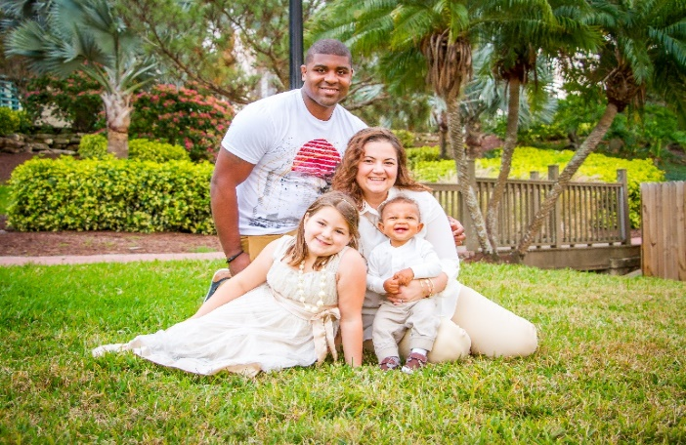
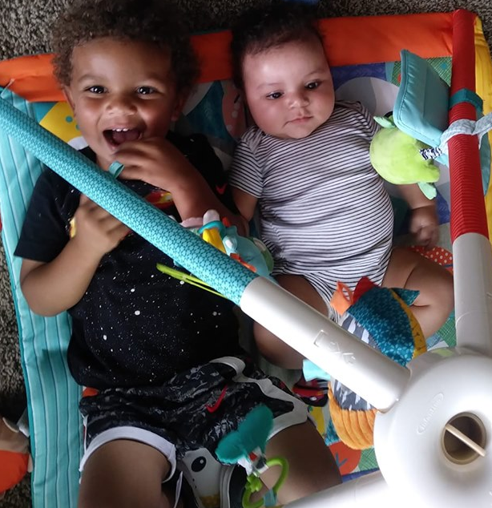
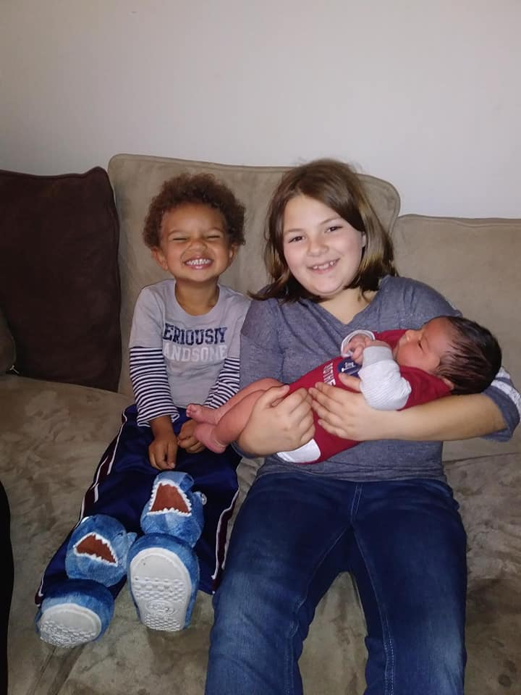
About me
Graduate of ST Petersburg College
Bachelor’s Degree in 3 yr olds through 3rd grade Education with ESOL and Reading endorsement at SPC
Master’s degree in Teaching and Learning at Liberty University.
Married with 3 children.
My hobbies include reading, family outings, and crafts.

Slide 4
Contact Information
I am available through the following ways:
Email: talleym@platoacademy.net
Phone:(727) 205-6360 **Please take a magnet with my information

Slide 5
Daily Schedule
8:40-8:50 Circle/Meeting
8:50-9:20 Science/ Social Studies
9:20-9:30 Calendar
9:30-10:00 Greek
10:00-10:20 Math 2
10:20-10:40 Recess
10:40-11:10 Lunch
11:10- 12:10 Math
12:10-12:30 ELA 2
12:30-1:20 Specials
1:20-3:10 ELA
3:10 Dismissal

Slide 6
Drop off and Pick up
School starts at 8:40, but students may enter the class at 8:15. If you dropping off your child, please do so at the door only for the first week. After that, you may not go past the lobby for security reasons.
If you are changing the way your child gets picked up, please send me an email and notify the office so we can get them to the correct place.

Slide 7
Attendance
Please try to have your children here every day and on time. We start learning right at 8:40, so I do not want them to miss anything. We only have 180 days to teach them everything and every day counts. I cannot always reteach the content to a child who has missed it. Keep in mind that if your child exceeds 15 unexcused absences, they may not be able to return next year. An intervention plan may also be put in place by administration. For every 10 days missed, your child’s letter grade will drop by one within that grading period. Also, if your child is tardy 3 times, it equals 1 absence.

Slide 8
Dress code
Girls: Plato shirt and navy blue or black bottoms. They may also wear the plaid dress.
Boys: Plato shirt and black or blue bottoms.
Friday uniform: Friday shirt and solid black mesh shorts
Jackets: Solid red with no logos
Shoe: Please wear closed-toe shoes, because they do go to PE three days a week. Also, please practice tying shoe laces with them if they do not already know.

Slide 9
Homework
Reading: 20 minutes Mon-Thurs
*Reading logs will be given at the beginning of the month and collected at the end of the month.
Math: Math review packet (4-5pages).
*These are given on Friday and due back the following Friday.
I will only allow them to be one day late (the following Monday) unless the child was absent.

Slide 10
Classroom rules
Be safe.
Be respectful
Be responsible
Have fun!
*We will review these rules often, please talk to your child about them ☺

Slide 11
Classroom behavior
We follow a color chart in our room.
*Colors will be written in their agendas every day. Please check them.
They will also earn “I got caught doing something good” tokens that they can use on Friday to buy prizes from the class store.

Slide 12
Volunteering
Please let me know if you are available to do any work for me at home, such as cutting things out or putting booklets together. You can also schedule a time to help out in the classroom.
We will also be asking for chaperones in advance for fieldtrips.
All volunteers that come into the school must have a level 2 background screening.

Slide 13
Meetings
During October I will be contacting you to set up a conference regarding your child’s progress. I will provide many days and times. Please make the time to schedule a conference, these are important for your child’s success.

Slide 14
Grades
Please make sure you are set up on Focus with your parent login. You can always view your child’s grade and assignments from there.
If you need your login, please present your driver’s license to the front office.

Slide 15
Thank you
For your help and support!
I’M EXCITED ABOUT THIS UPCOMING SCHOOL YEAR!

